Slide 1

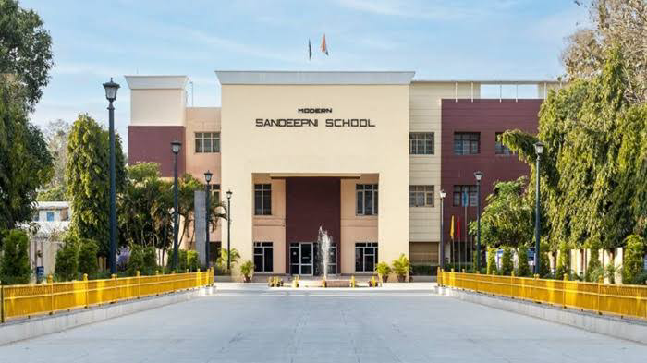
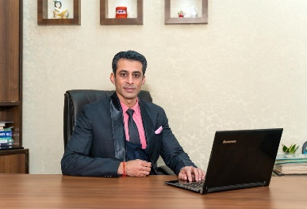
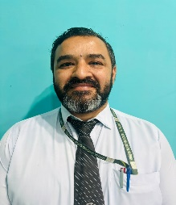
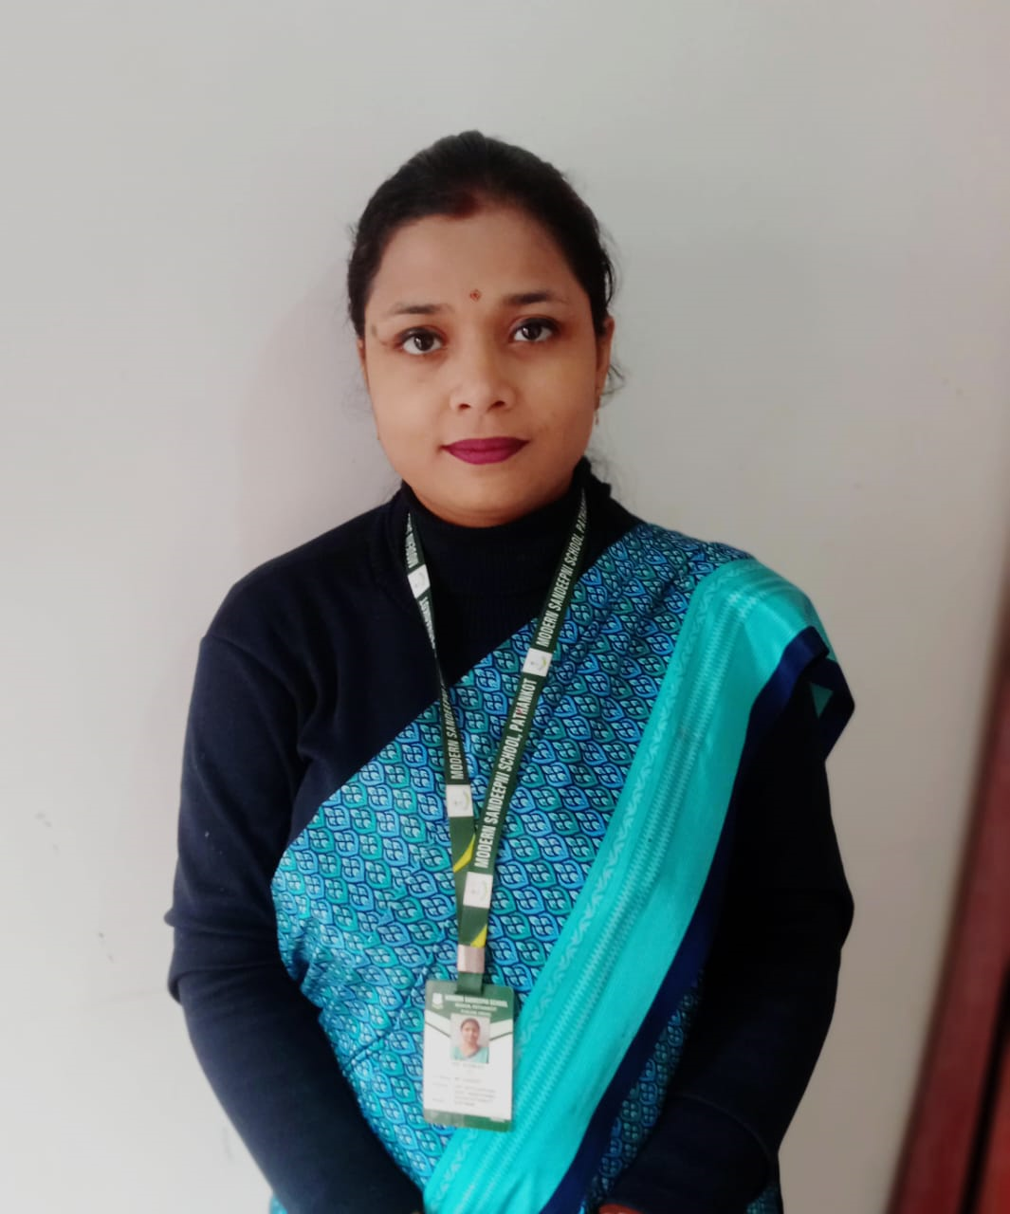
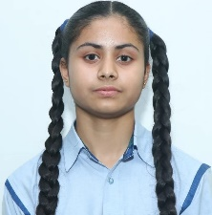
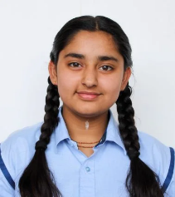
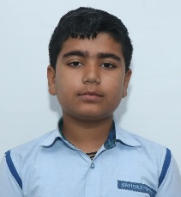
Volume: IV Issue-9
Dercember2025
The Sandeepni Chronicle
Editorial Team
DR. Neeraj Mohan Puri
Principal
Mr. Sushil
Editor
Ms. Komal
Sub- Editor
Student Editors
Manasvi
(XI-Med)
Vaanya
(X-Peace)
Aditya Mehra
(X-Loyal)
The Sandeepni Chronicle | December2025

Slide 2
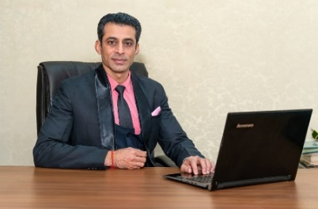
FIRST LOOK
Parental Involvement
Parental involvement is one of the most reliable predictors of a student's behavioral health. Decades of research, including recent meta-analyses covering hundreds of studies, show that when parents engage with their child's education, it creates a "social constraint" and a support system that significantly reduces classroom disruptions.
​Positive Behavioral Outcomes
1. ​Active involvement—ranging from attending parent-teacher conferences to discussing school days at home—leads to several key improvements:
2. ​Reduction in Aggression & Defiance: Students with involved parents are less likely to exhibit "externalizing" behaviors, such as fighting, bullying, or defiance toward authority.
3. ​Improved Self-Regulation: Parental support helps students develop autonomy and emotional control, reducing impulsive actions in the classroom.
4. ​Lower Absenteeism: Research shows that even simple interventions, like schools sending reminders to parents about attendance, can reduce chronic absenteeism by up to 15%.
4. ​Enhanced Social Skills: These students typically adapt better to school environments, showing higher levels of empathy and better relationships with peers.
5. Sense of Value: When parents show interest, children perceive school as a high-priority environment, increasing their intrinsic motivation.
6. ​Self-Esteem: Positive reinforcement from home builds a buffer of resilience, making students less likely to act out due to frustration or low self-confidence.
Dr. Neeraj Mohan Puri
The Sandeepni Chronicle | December 2025

Slide 3

SELF MOTIVATION
From the Editor’s Desk
Self-motivation is the internal drive to act and achieve goals without external pressure, fueled by personal desires, commitment, initiative, and resilience, making you proactive, organized, and confident in pursuing self-improvement and success. It involves understanding your "why," setting clear goals (both short and long-term), developing discipline through habits, and staying optimistic to overcome challenges. Developing this skill requires consistent self-awareness and techniques like positive self-talk, eliminating distractions, and rewarding small wins.
Key Components
Personal Drive: Desire to improve and meet standards.
Commitment: Sticking with goals despite difficulties.
Initiative: Readiness to act on opportunities.
Optimism/Resilience: Persisting through setbacks.
Self-Efficacy: Belief in your ability to succeed.
How to Build Self-Motivation
Clarify Your "Why": Understand your core values and purpose.
Set Clear Goals: Define specific, realistic short-term and long-term goals.
Build Habits: Link new actions to existing daily routines (e.g., "If I drink coffee, then I'll study for 5 mins").
Track Progress: Monitor achievements to build confidence and momentum.
Reward Yourself: Acknowledge small wins to stay positive.
Minimize Distractions: Create a focused environment by removing temptations.
Practice Positive Self-Talk: Maintain an optimistic mindset and filter negativity.
The Sandeepni Chronicle | December 2025

Slide 4

Parent’s Pen
Family Values
Family values are the guiding beliefs and priorities that shape how a family interacts, makes decisions, and functions as a unit. They act as a moral compass, helping members distinguish right from wrong and fostering a sense of identity and belonging.
Common Core Family Values
While unique to every home, several values are universally recognized for building strong bonds:
Respect: Valuing each member's thoughts, feelings, and boundaries, regardless of age.
Honesty: Prioritizing truthfulness to build a foundation of trust and reliability.
Responsibility: Encouraging accountability for one's actions and contributing to household chores.
Empathy and Compassion: Seeking to understand and share the feelings of others both inside and outside the home.
Perseverance: Teaching resilience to face challenges and mistakes as opportunities for growth.
Why Family Values Matter
Decision-Making: They simplify complex choices by providing a pre-established set of priorities.
Emotional Security: Shared values create a predictable and safe environment, particularly for children.
Identity: They define what the family stands for, helping children navigate outside influences and peer pressure.
How to Establish Your Own Values
Brainstorm: Hold a family meeting to discuss what matters most to each person..
Create Traditions: Use shared meals, game nights, or volunteering to reinforce values through action
Proud mother of drisha
.
The Sandeepni Chronicle | December 2025

Slide 5
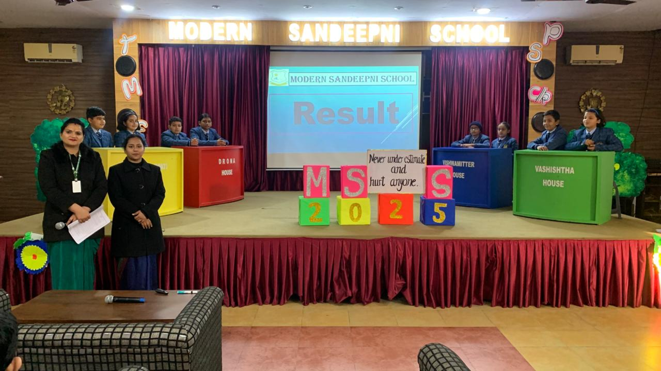
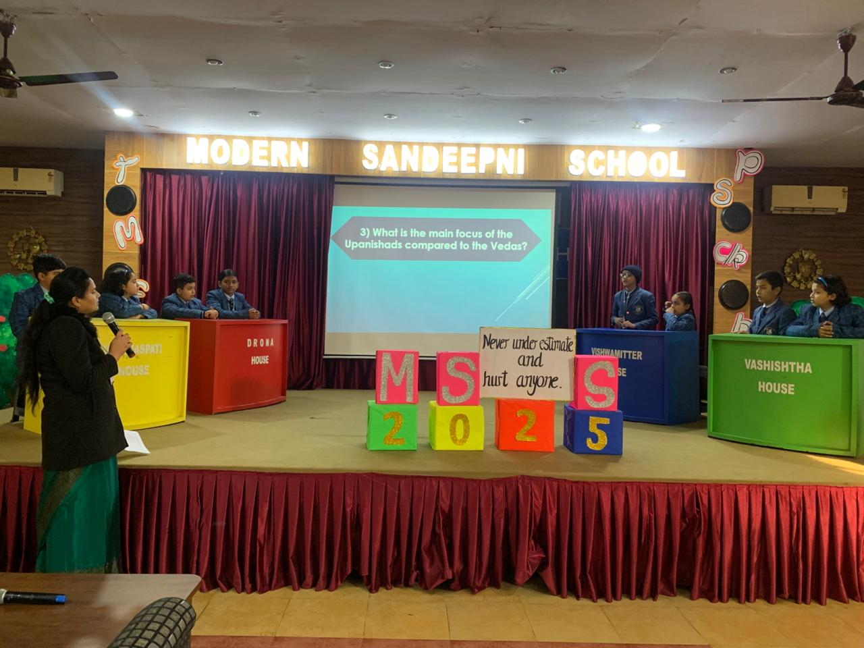
Quiz on Vedas And Upanishads
By:- Ms. Kajal
A quiz competition based on the theme Vedas and Upanishads was successfully conducted on 16 December 2025. The objective of the quiz was to enhance students’ knowledge of ancient Indian scriptures and to promote awareness of our rich cultural and spiritual heritage. The competition witnessed enthusiastic participation from the four school houses namely Vishwamitter, Varishaspati, Vashishtha and Drona. Students actively participated and displayed commendable understanding, confidence, and teamwork throughout the event. The quiz consisted of well-structured rounds that tested students’ knowledge, reasoning ability, and presence of mind. The participants showed great interest and maintained healthy competitive spirit during the competition .Based on the overall performance, the results were as follows :First Position: Varishaspati House Second Position: Vishwamitter House Third Position: Drona House Varishaspati House secured the first position with excellent performance and consistent accuracy in responses. Vishwamitter house stood second, followed closely by Drona House at third position. The quiz competition proved to be an enriching and educational experience for all participants. It successfully met its objectives and encouraged students to learn beyond textbooks while fostering teamwork and confidence. The event concluded on a positive note with appreciation for all participating houses.
The Sandeepni Chronicle | December 2025

Slide 6
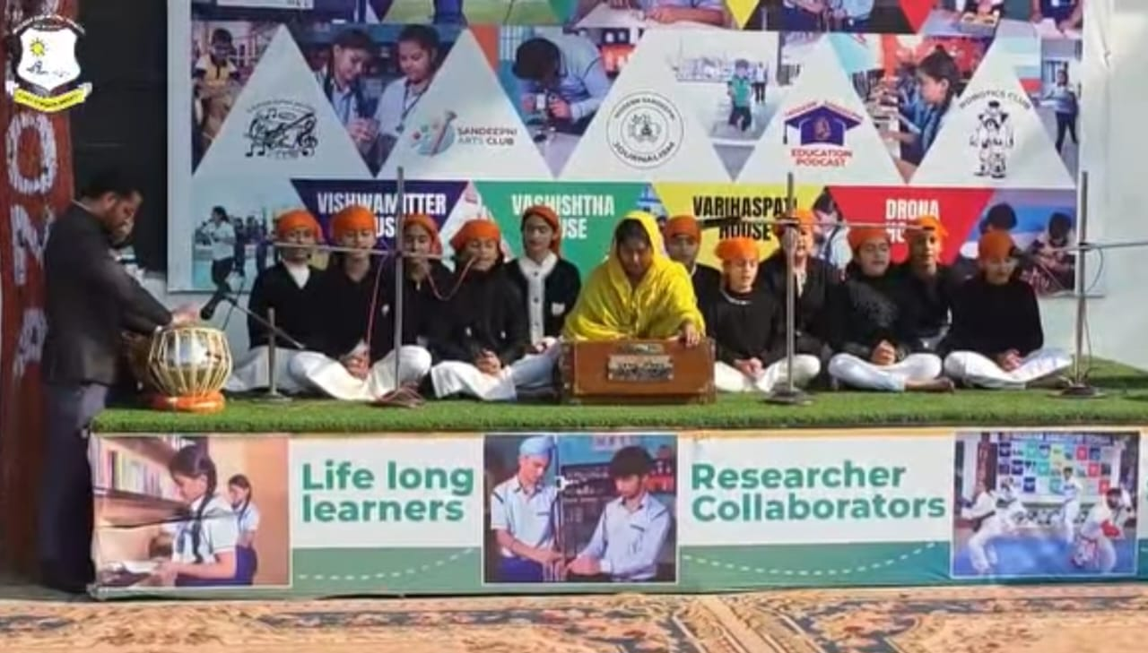
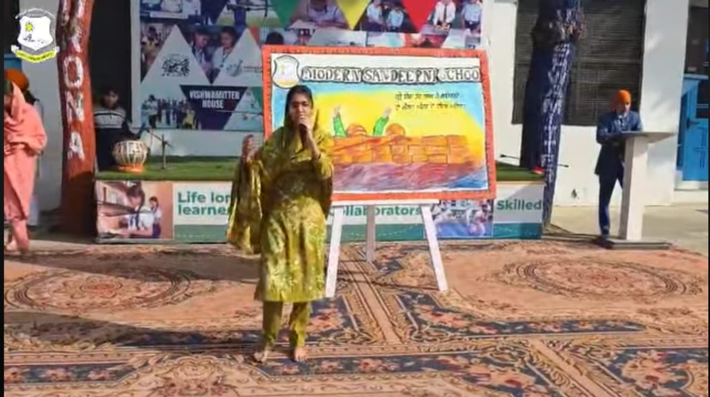
Martyrdom Day Of Char Sahibzade
By:- Ms. Navneet
To give a powerful reminder of moral strength, national pride our school celebrated Martyrdom day on 24 December . The occasion was graced by our esteemed Director Er. Pawan Mahajan, Chairman Captain Salil Mahajan, , and Manageress Mrs. Pinky Mahajan and Principal Dr Neeraj Mohan Puri.The event began with the ceremonial lighting of the lamp, setting a divine tone for the day. Students beautifully sang the shabad related to their history , paying homage to the legacy of sahib jade zorzwar Singh ji, Fateh Singh, Ajit Singh ji and Jujhar Singh ji through soulful music.
This was followed by an impressive dramatization that showcased the journey of Sahibzada Ji, In his address, Director Er. Pawan Mahajan shared valuable words of wisdom, urging students to walk on the path of righteousness and emulate the virtues of Sahibzada in their lives.
Chairman Captain Salil Mahajan explained their sacrifice when they were bricked alive in the wall for refusing to convert to Islam in Sirhind Chairman Captain Salil Mahajan and Manageress Mrs. Pinky Mahajan and principal Dr. Neeraj Mohan Puri praised the dedication of students and staff for putting together such a meaningful and culturally rich celebration. Also give them best wishes for new year.
The Sandeepni Chronicle | December 2025

Slide 7
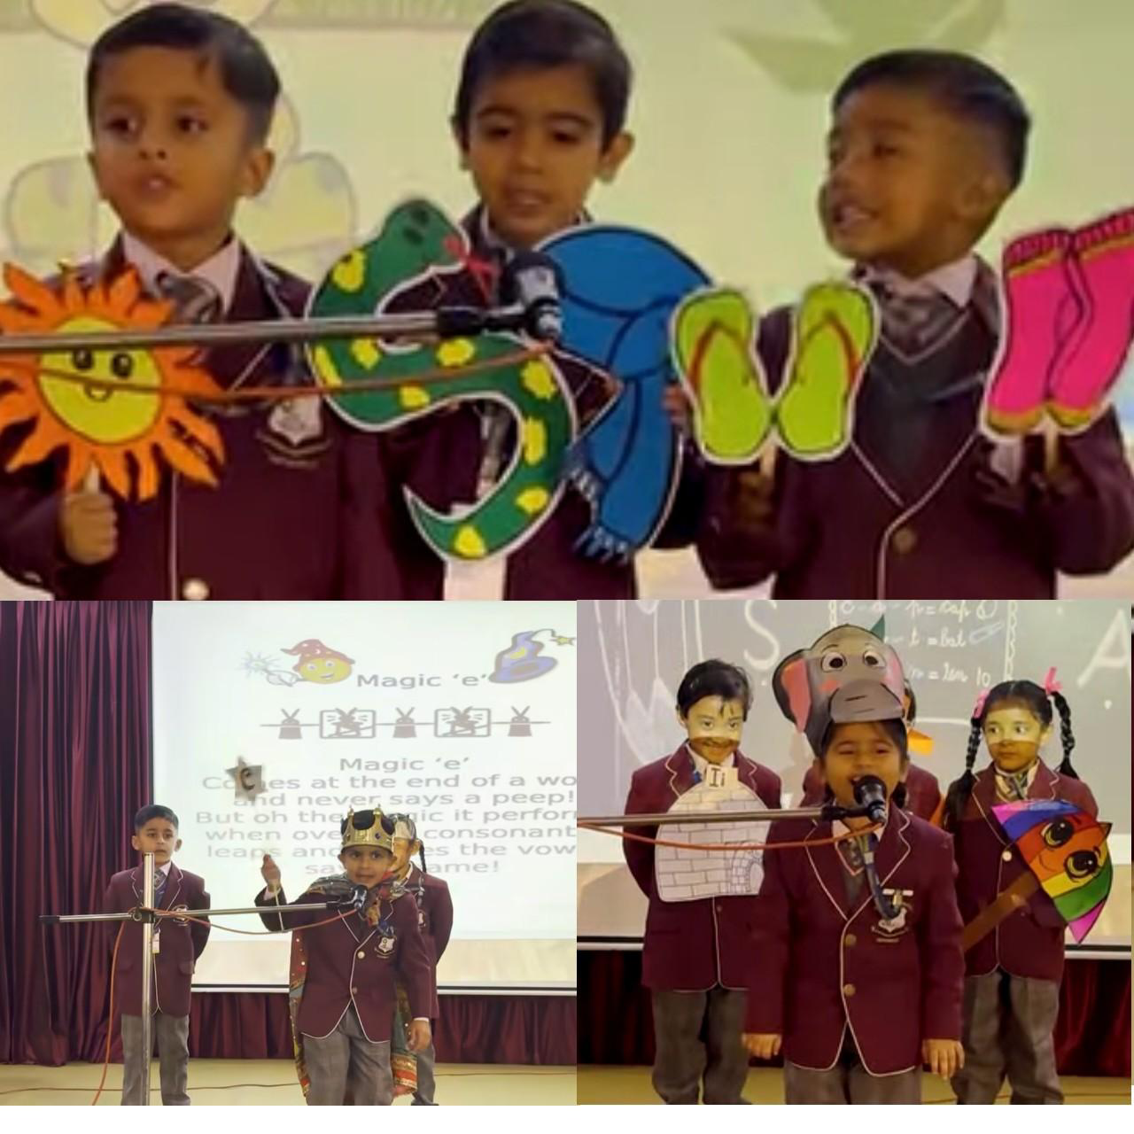
Phonics Workshop
By:- Ms. Pooja
Modern Sandeepni School, Pathankot organized a Phonics Workshop on 6th December 2025 in the school auditorium. The session was conducted by kindergarten teachers under the guidance of our Honourable Principal Dr. Neeraj Mohan Puri and ma’am M.S Navjot Mahajan to create awareness among parents about phonics sound.
Mr Shashi Bhushan also provide certain tips to the students to raise awareness about phonics among parents and showcase the efforts of kindergarten students.
Parents thoroughly enjoyed the phonics session, appreciating the interactive activities and efforts of the teachers and students. The workshop was praised for making phonics learning fun and engaging. Many parents expressed gratitude for the valuable insights gained. Overall, it was a highly appreciated session!
The Sandeepni Chronicle | December 2025

Slide 8
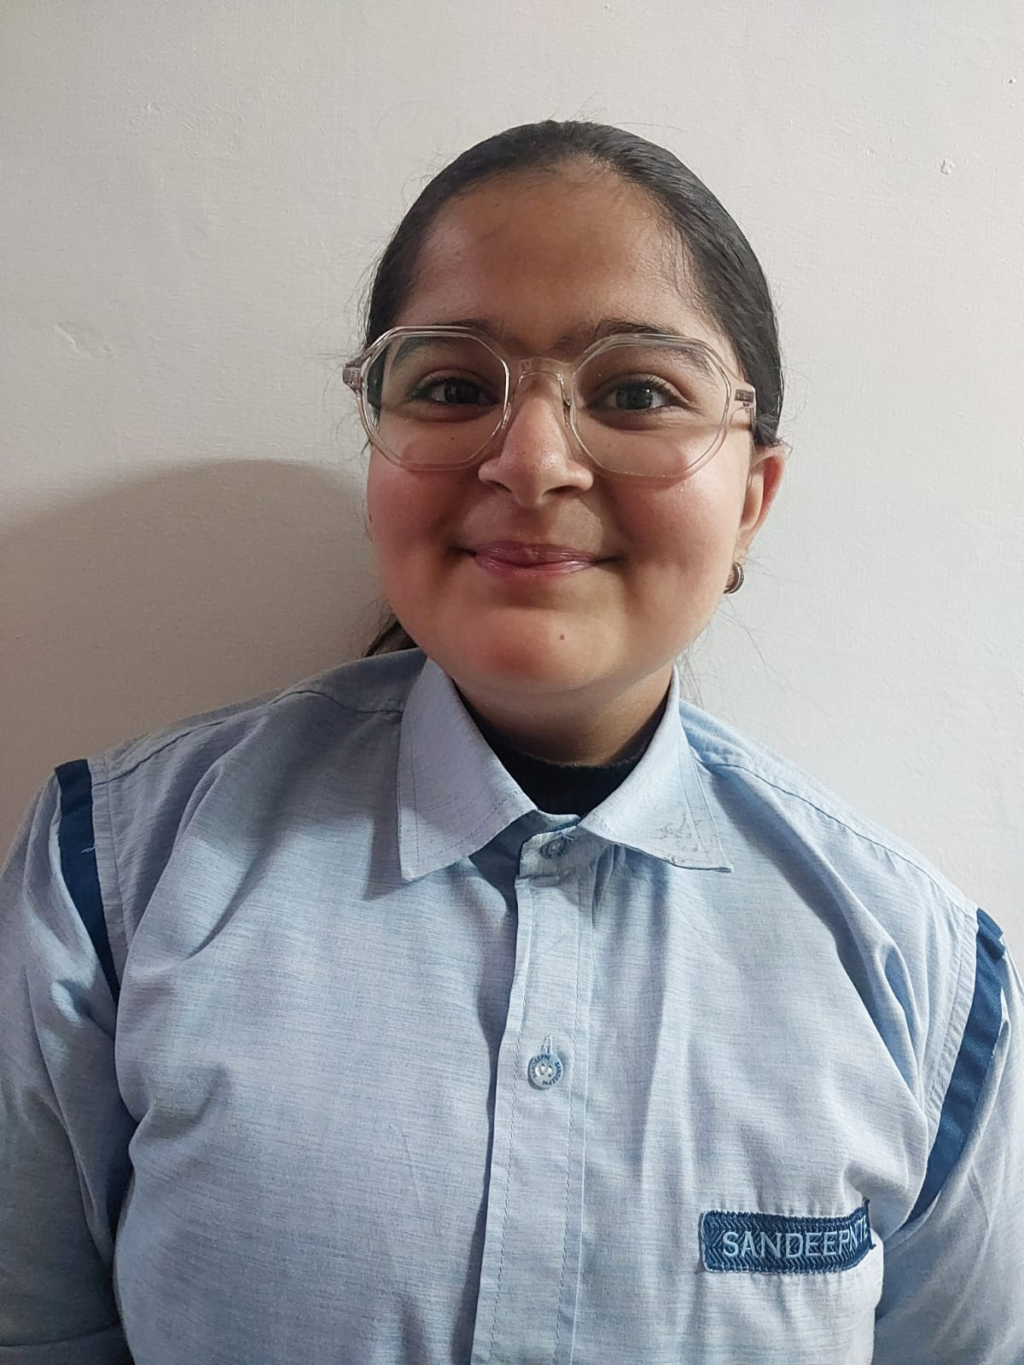
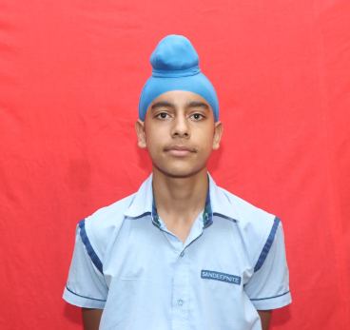
Understanding Others Is A Great Skill
Article by:- Bhavika (5th L)
Understanding others is a cornerstone of emotional intelligence (EQ) and a vital life skill that directly impacts personal well-being and professional success. here are the key ways to master and apply this skill:
1. Essential Components
To understand others, you must integrate several related skills:
Perspective-Taking: The ability to step outside your own mental frame and imagine someone else's thoughts and experiences.
Active Listening: Going beyond just hearing words to grasp the underlying emotions and intentions.
Reading Non-Verbal Cues: Interpreting body language, facial expressions, and micro-shifts in demeanor that often reveal more than speech.
Suspending Judgment: Approaching others with curiosity rather than criticism, which creates the "psychological safety" needed for them to open up.
2. Why it Matters in 2026
In an increasingly complex and automated world, human-centered skills are more valuable than ever:
At Work: Empathetic leadership has been shown to boost employee innovation (61%) and engagement (76%) while reducing turnover.
In Conflict: Most disagreements stem from miscommunication. Taking time to understand the "logic" behind another person's opinion can defuse tension, even if you don't agree with them.
For Personal Health: Strong social connections fostered by understanding others are linked to better mental health
The Sandeepni Chronicle | December 2025

Slide 9

Sustainability
Article by:- Kartik (7th L)
Sustainability is the ability to maintain or support a process continuously over time without depleting natural or physical resources. In a modern context, it refers to meeting the needs of the present without compromising the ability of future generations to meet their own needs.
The Three Pillars of Sustainability
True sustainability is achieved by balancing three interconnected dimensions, often called the Triple Bottom Line:
Environmental Sustainability: Protecting the planet by managing resources like water, air, and soil to ensure ecological systems remain balanced.
Social Sustainability: Promoting equity, human rights, and well-being. This ensures everyone has access to basic needs like healthcare, education, and fair labor.
Economic Sustainability: Encouraging long-term, inclusive economic growth that generates wealth without causing environmental damage or social injustice.
Global Goals and Action:The United Nations' 2030 Agenda provides a roadmap for global sustainability through 17 Sustainable Development Goals (SDGs), which target issues like poverty, climate change, and inequality.
Practical Steps for Individuals:
Reduce Waste: Practice the "reduce, reuse, recycle" mantra to minimize landfill contributions.
Conserve Energy: Switch to LED bulbs, unplug "vampire" devices, and opt for renewable energy sources.
Mindful Consumption: Avoid fast fashion, reduce meat consumption, and choose locally sourced or fair-trade products.
.
The Sandeepni Chronicle | December 2025

Slide 10
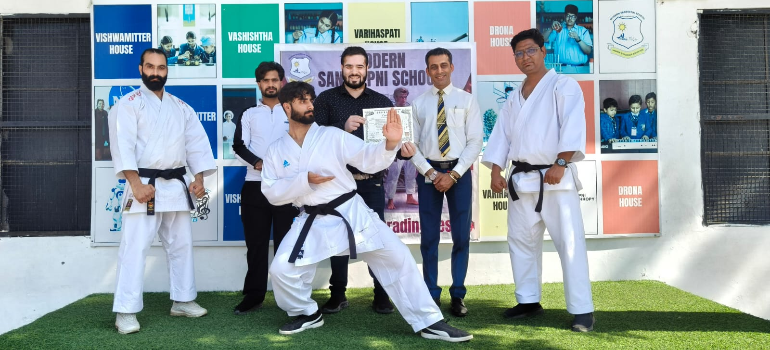
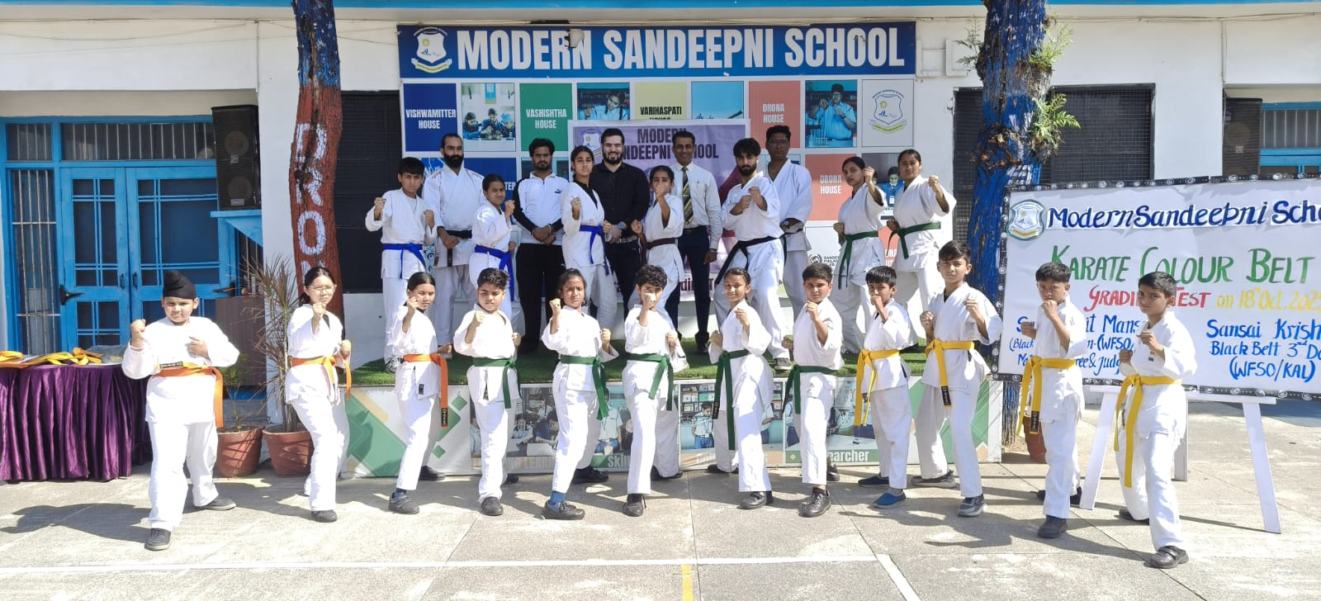
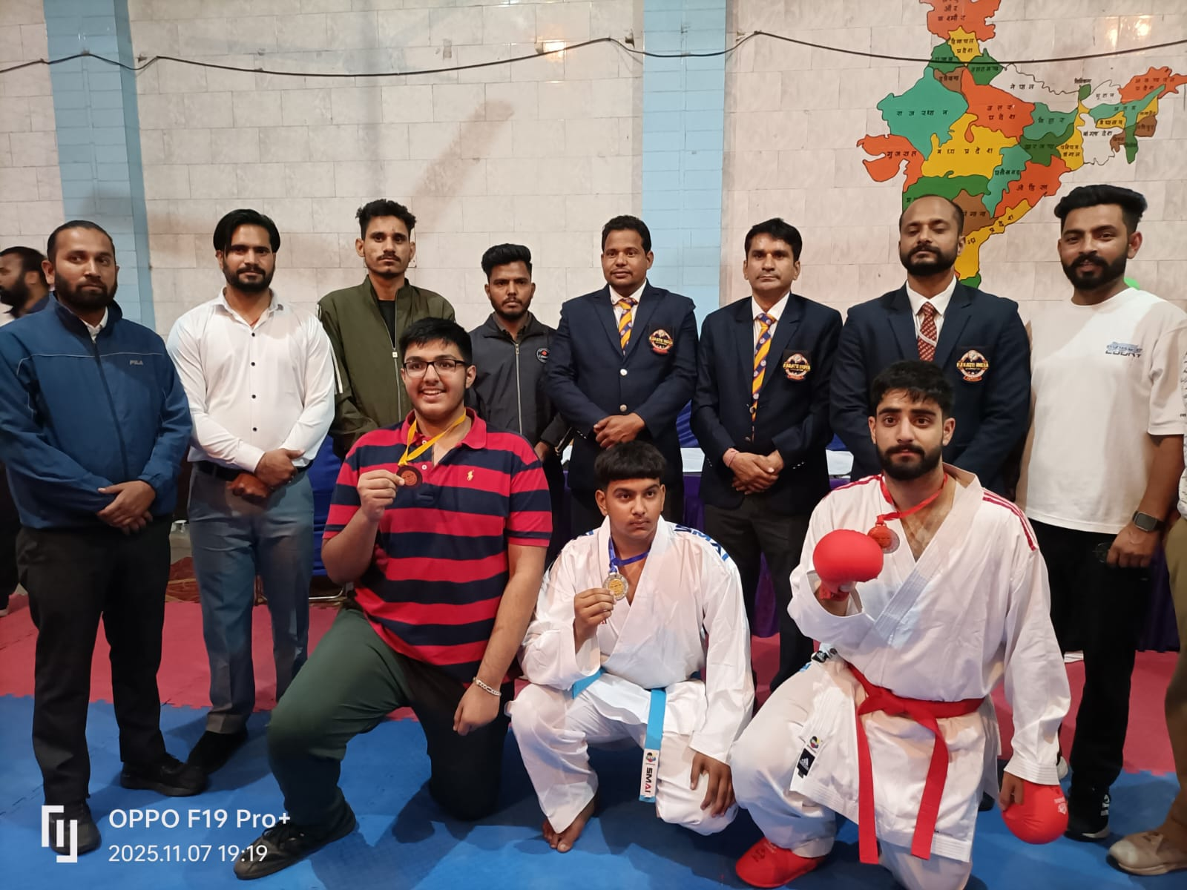
Karate Tournament
by:- Ms. Anil
Karate is a Japanese martial art and combat sport that uses striking techniques with the hands, feet, elbows, and knees, as well as blocking and grappling, for self-defense and physical and mental discipline. A practitioner of karate is called a karateka.
It was the honour as sandeeepni that In 69 punjab state under district school games 2025-26 our students got participated on the behalf of pathankot district and our students Mir sarwar kaiser and sparsh chaudhary were participated and Mir sarwar kaisar got gold medal(1st prize) and selected for national school games.
In girls ,Dhriti puri and aradhya participate 69 punjab sstate under district school games 2025-26 and here Aradhya got 2nd position (silver medal)
While playing , our students displayed discpline and sportsmanship. competing against some of the best players in the district they performed with confidence and determination, making their mark in their respective events.
The Sandeepni Chronicle | December 2025

Slide 11
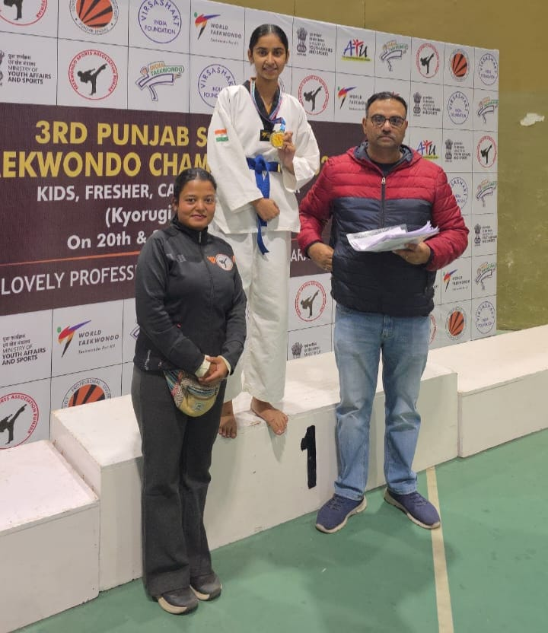
Taekwondo Championship
by:- Ms. Tanvi
The 3rd punjab state open Taekwondo championship was held at LPU jaipur with great enthusiasm and sportsmanship. The event brought together talented young athletes from across the state, showcasing their skills, determination, and passion for sports.
It is a matter of great pride that students from our school—Sarika and Mehreen proudly represented us in this prestigious tournament. Their participation not only reflected their hard work and dedication but also the school’s commitment to promoting sports and overall development among students.
Throughout the tournament, our players displayed excellent discipline, and sportsmanship. Competing against some of the best players in the state, they performed with confidence and determination, making their mark in their respective events. Their spirited participation was appreciated by coaches and spectators alike.
Such events provide a valuable platform for young players to enhance their sporting abilities and gain exposure to higher levels of competition. The experience our students gained from this tournament will certainly motivate them to strive harder and achieve even greater success in the future.
The school congratulates, sarika who got gold medal and also qualifies for 2nd federation cup going to be held at jaipur. and Mehreen for their commendable performance and for bringing honor to the institution. Their participation in the State Level Tournament is indeed a moment of pride for all Sandeepnites
The Sandeepni Chronicle | December 2025

Slide 12

ਸੱਚਾਈ
ਸੱਚਾਈ ਮਨੁੱਖ ਦੇ ਜੀਵਨ ਦਾ ਸਭ ਤੋਂ ਵੱਡਾ ਗੁਣ ਹੈ। ਸੱਚ ਬੋਲਣ ਵਾਲਾ ਵਿਅਕਤੀ ਹਰ ਥਾਂ ਆਦਰ ਅਤੇ ਸਨਮਾਨ ਪ੍ਰਾਪਤ ਕਰਦਾ ਹੈ। ਸੱਚਾਈ ਨਾਲ ਮਨੁੱਖ ਦਾ ਮਨ ਸ਼ਾਂਤ ਰਹਿੰਦਾ ਹੈ ਅਤੇ ਉਸ ਦਾ ਜ਼ਮੀਰ ਸਾਫ਼ ਹੁੰਦਾ ਹੈ।
ਸੱਚ ਦਾ ਰਸਤਾ ਥੋੜ੍ਹਾ ਔਖਾ ਜ਼ਰੂਰ ਹੁੰਦਾ ਹੈ, ਪਰ ਅੰਤ ਵਿੱਚ ਜਿੱਤ ਸੱਚ ਦੀ ਹੀ ਹੁੰਦੀ ਹੈ। ਝੂਠ ਬੋਲਣ ਨਾਲ ਕੁਝ ਸਮੇਂ ਲਈ ਫਾਇਦਾ ਹੋ ਸਕਦਾ ਹੈ, ਪਰ ਬਾਅਦ ਵਿੱਚ ਮੁਸ਼ਕਲਾਂ ਦਾ ਸਾਹਮਣਾ ਕਰਨਾ ਪੈਂਦਾ ਹੈ।
ਸੱਚਾਈ ਨਾਲ ਵਿਸ਼ਵਾਸ ਬਣਦਾ ਹੈ। ਪਰਿਵਾਰ, ਸਕੂਲ ਅਤੇ ਸਮਾਜ ਵਿੱਚ ਸੱਚ ਬੋਲਣ ਵਾਲੇ ਵਿਅਕਤੀ ਨੂੰ ਹਰ ਕੋਈ ਪਸੰਦ ਕਰਦਾ ਹੈ। ਮਹਾਤਮਾ ਗਾਂਧੀ ਜੀ ਨੇ ਵੀ ਸੱਚ ਅਤੇ ਅਹਿੰਸਾ ਦੇ ਰਸਤੇ ‘ਤੇ ਚੱਲ ਕੇ ਦੇਸ਼ ਨੂੰ ਆਜ਼ਾਦੀ ਦਿਵਾਈ।
ਇਸ ਲਈ ਸਾਨੂੰ ਹਮੇਸ਼ਾਂ ਸੱਚ ਬੋਲਣਾ ਚਾਹੀਦਾ ਹੈ ਅਤੇ ਸੱਚਾਈ ਦੇ ਰਸਤੇ ‘ਤੇ ਚੱਲਣਾ ਚਾਹੀਦਾ ਹੈ। ਸੱਚਾਈ ਨਾਲ ਹੀ ਜੀਵਨ ਸੁੰਦਰ ਅਤੇ ਸਫਲ ਬਣਦਾ ਹੈ।
The Sandeepni Chronicle | December 2025

Slide 13
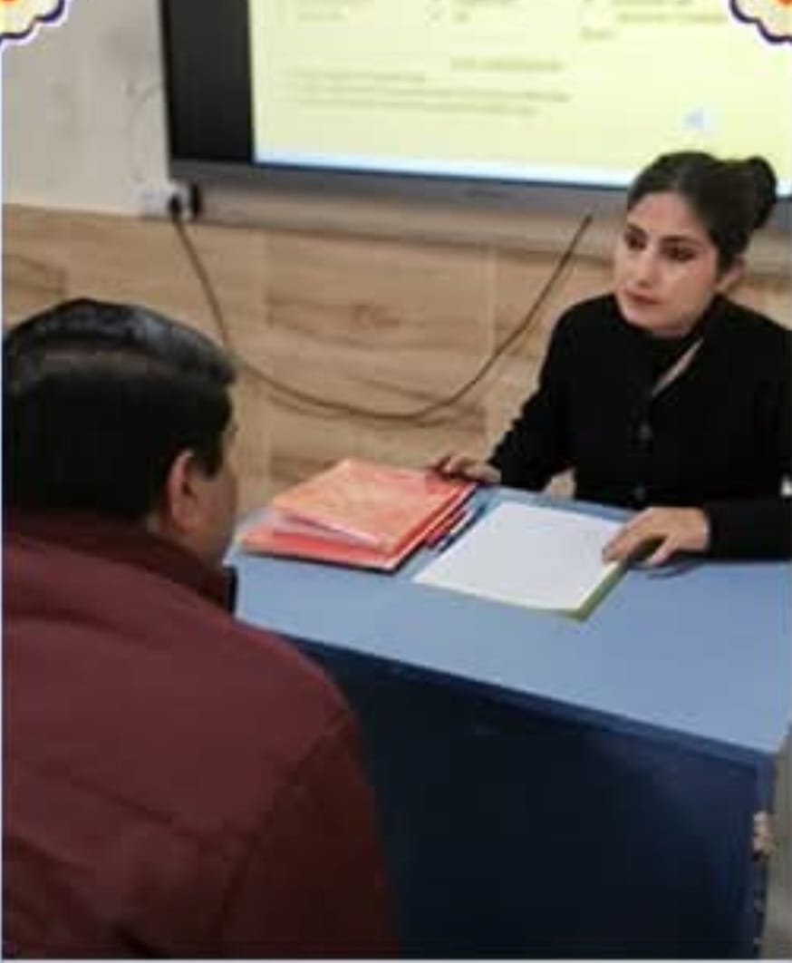
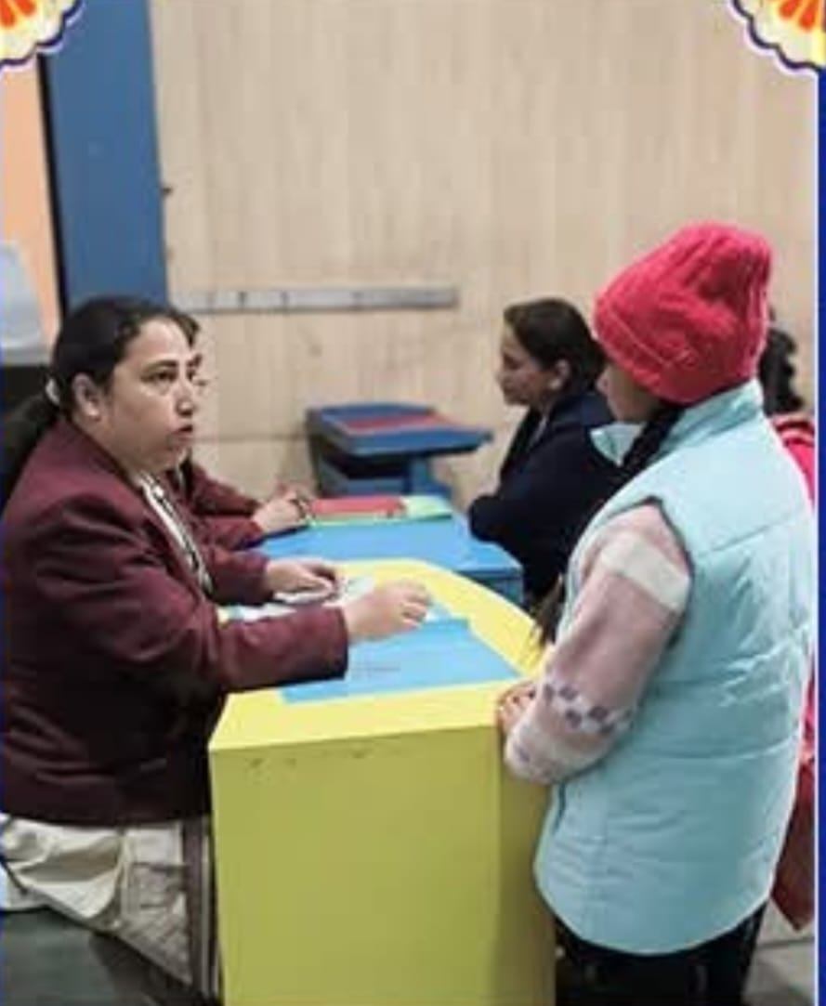
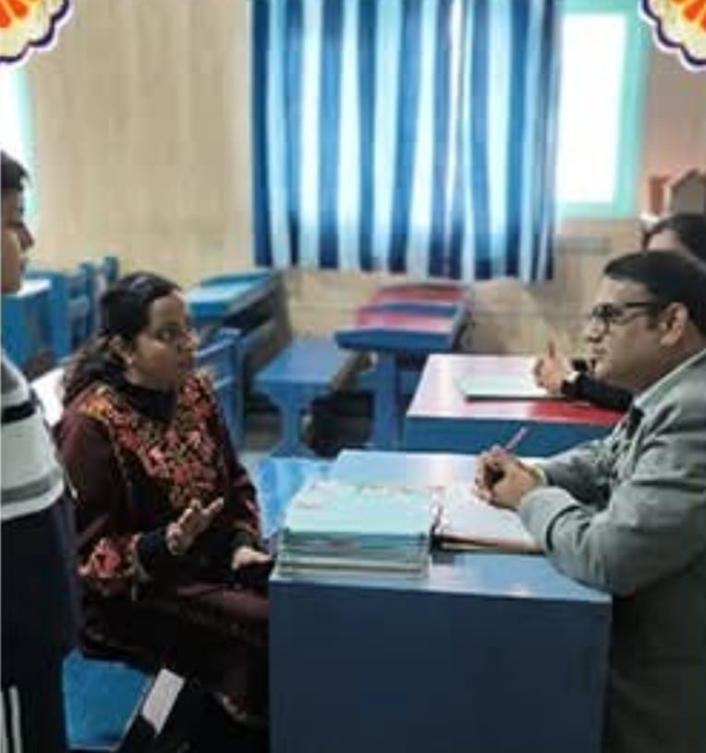
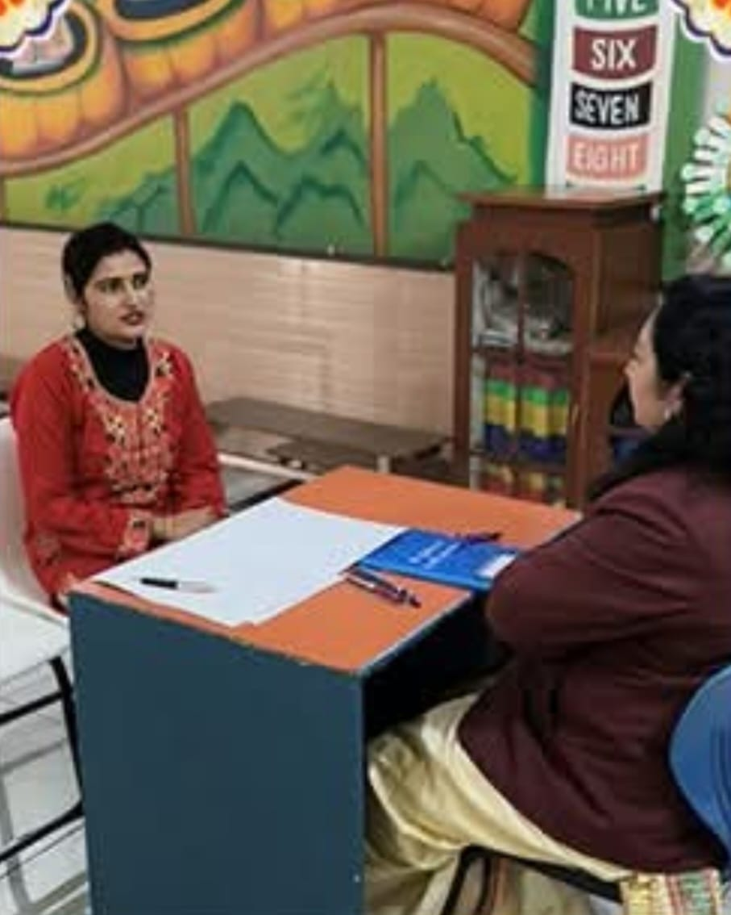
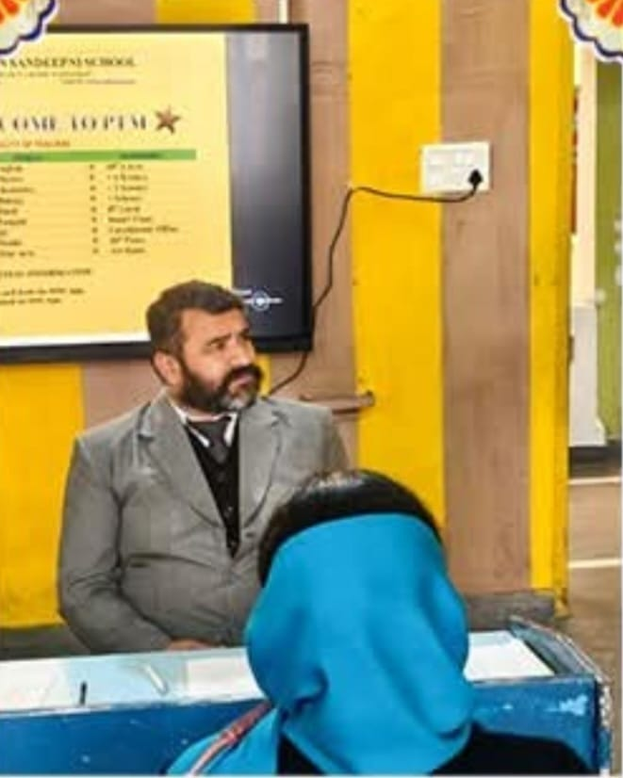
Glimpse Of PTM
Glimpse of PTM

Slide 14
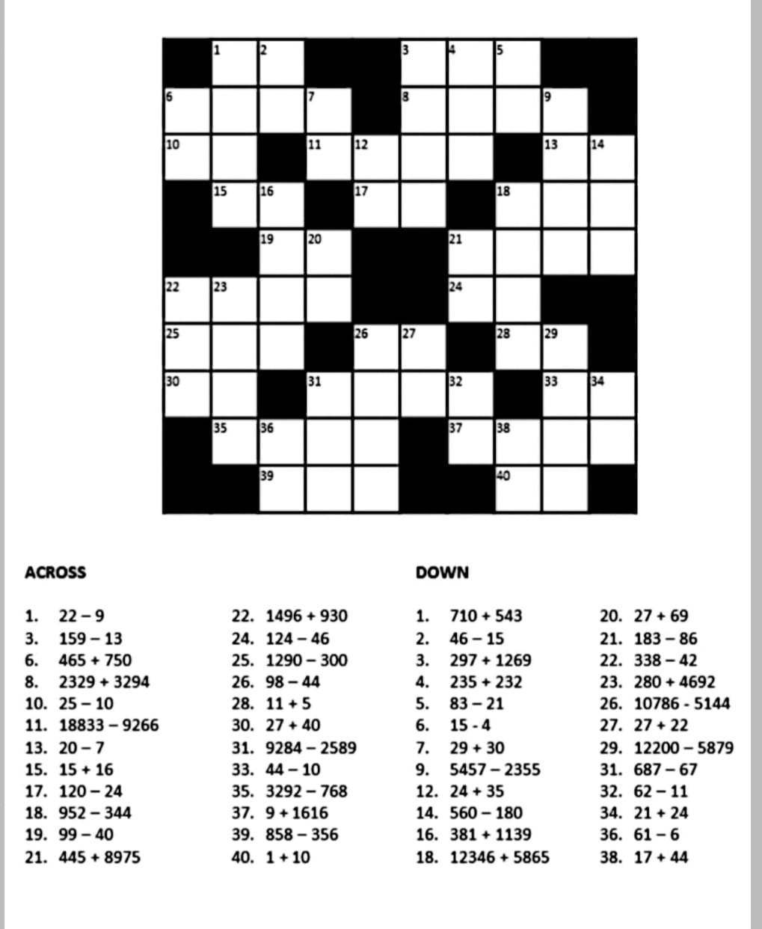
PUZZLE

Slide 15
Amazing Facts
​🌌 Space & Planets​A Day vs. A Year: On the planet Venus, a single day is longer than a whole year. It takes Venus longer to spin once on its axis than it does to orbit the Sun. ​The Big Squeeze: If you could squeeze all the empty space out of the atoms that make up every human on Earth, the entire world population would fit inside a single sugar cube.​Diamond Rain: On Neptune and Uranus, scientists believe it literally rains diamonds because of the extreme pressure in their atmospheres. ​Moon Footprints: Because there is no wind or water on the Moon, the footprints left by the Apollo astronauts will stay there for at least 100 million years.
.​🧠 Human Body & Science​The Lightbulb Brain: Your brain generates enough electricity (about 12–25 watts) to power a low-wattage LED lightbulb. ​Radioactive Fruit: Bananas are slightly radioactive because they contain Potassium-40. Don't worry, though—you’d have to eat 10 million of them at once to get radiation poisoning! ​Fastest Muscle: The muscles that help your eyes blink are the fastest muscles in your body. They can contract in less than one-hundredth of a second.​The Tallest Grow: Astronauts can grow up to 2 inches taller while in space because the lack of gravity allows their spine to expand.
​
The Sandeepni Chronicle | December 2025

Slide 16

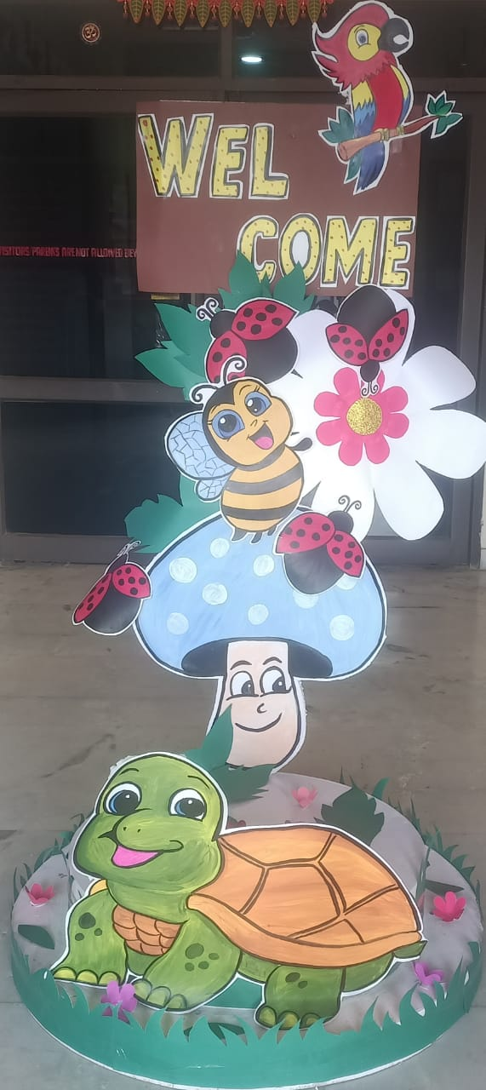
By Art & Craft Department
The Sandeepni Chronicle | December 2025

Slide 17

Team Sandeepni
Team Sandeepni
Team Sandeepni
The Sandeepni Chronicle |December 2025

