Slide 1
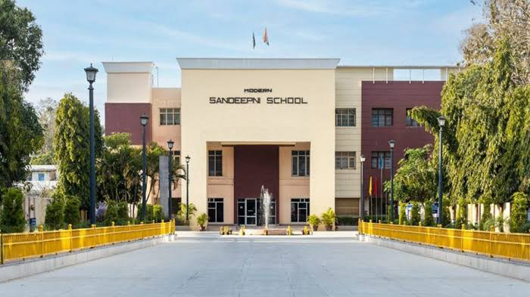
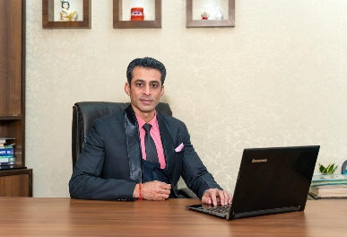
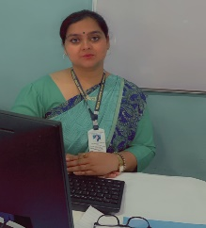
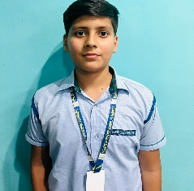
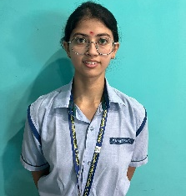
Volume: III Issue-9
DECEMBER 2024
The Sandeepni Chronicle
Editorial Team
DR. Neeraj Mohan Puri
Principal
Ms. Prabhjot Kaur
Editor
Mr. Vikram
Art & Design
Student Editors
Bhavesh (XI Sci)
Jiya (XI Hum)
Dhriti (X Loyal)

Slide 2
FIRST LOOK
Impact of Social Media on Mental Health of Students
Social media has become an integral part of students' lives, offering platforms for communication, self-expression, and learning. However, its excessive use has raised concerns about its impact on students' mental health. Constant exposure to curated, idealized lifestyles often leads to feelings of inadequacy, anxiety, and depression. For instance, a student comparing their academic performance or social life to others on Instagram might experience self-esteem issues.
Moreover, the addictive nature of social media can disrupt sleep patterns and reduce focus on academic tasks. Cyberbullying is another serious issue, where negative comments or online harassment can deeply affect a student’s emotional well-being. According to studies, students who spend more than three hours daily on social media are at a higher risk of developing symptoms of anxiety and depression.
On the positive side, social media can offer support groups and mental health resources, helping students cope with stress. For example, platforms like Reddit and mental health-focused Facebook groups allow students to share experiences and seek advice.
To ensure a healthy balance, students must practice mindful social media usage, set time limits, and focus on building real-life connections alongside their online presence
Enjoy Reading!
Have a progressive and rewarding year ahead.
Dr. Neeraj Mohan Puri
The Sandeepni Chronicle

Slide 3
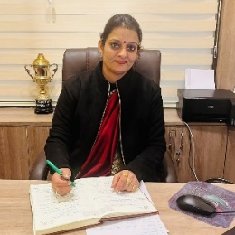
Positivity: The Only Path to Greatness
Ms. Deeksha Bhardwaj ( Vice Principal)
Positivity is more than just a nice attitude; it serves as a foundational element of achievement. Whether it’s in sports, business or art, the right mindset sets the stage for extraordinary results. Therefore, embracing a positive outlook is essential for reaching greatness.
Positivity in Action: Cultivating a Positive Mindset
Identifying and Challenging Negative Thoughts :- Recognizing negative thoughts is the first step in overcoming them. Techniques like cognitive restructuring can help. Start by listing negative thoughts and then challenge their validity. Counteract them with positive affirmations to shift your perspective.
Practicing Gratitude :- Gratitude can significantly boost positivity. By acknowledging the good in your life, you foster a sense of appreciation. Some ways to practice gratitude include:
Gratitude journaling: Write down three things you're grateful for each day.
Expressing appreciation: Telling someone how much they mean to you can strengthen personal connections.
Positive Self-Talk: Replacing negative self-talk with encouraging statements can transform your mindset. Instead of saying, "I can't do this," replace it with, "I’ll give it my best shot." This simple shift can enhance confidence and motivation.
Positivity and Goal Achievement: Turning Dreams into Reality
Setting SMART Goals :- Establishing goals that are Specific, Measurable, Achievable, Relevant, and Time-bound (SMART) is essential. Positivity plays an essential role in setting and reaching these goals. When you visualize success, you're more likely to achieve it.
Overcoming Obstacles with a Positive Outlook :- Many successful individuals have faced tremendous adversity but triumphed through a positive mindset. For instance, Thomas Edison once said, "Many of life's failures are people who did not realize how close they were to success when they gave up." His outlook shaped his achievements and demonstrated resilience.
Visualizing Success:- Visualization is a powerful tool. Imagining your success helps solidify your goals. Research shows that when athletes visualize their performance, their outcomes improve. Coupled with positive affirmations, this technique can drive you toward reaching your dreams.
Positivity in Relationships: Building Strong Connections
The Impact of Positivity on Interpersonal Dynamics:- A positive attitude can significantly enhance relationships. When you approach interactions with optimism, you foster trust and collaboration. This dynamic is key in both personal and professional settings.
Communication Strategies for Positive Interactions :- Effective communication is vital for maintaining relationships. Some strategies include:
Active listening: Show genuine interest in others' perspectives.
Empathy: Understand and validate feelings to create deeper connections.
Assertive communication: Expressing yourself positively promotes healthy dialogues.
Resolving Conflicts Positively: When conflicts arise, a positive approach can help navigate them. Focus on collaboration and finding solutions that benefit everyone involved. This mindset leads to stronger relationships and mutual respect.
Maintaining Positivity: Strategies for Long-Term Success
Building Resilience:- Resilience enables you to bounce back from setbacks. Focus on self-care practices like exercise, meditation, and maintaining a balanced diet to nurture resilience.
The Importance of Self-Compassion :- Being kind to yourself during tough times is essential. Self-compassion acts as a buffer against negative thoughts, helping to maintain a positive mindset.
Cultivating a Supportive Community:- Surrounding yourself with supportive people can reinforce a positive outlook. Build a network of friends and mentors who uplift you and share your commitment to positivity.
Conclusion: Embracing the Path to Greatness through Positivity :- In summary, positivity serves as a vital pathway to personal and professional success. By embracing strategies to cultivate a positive mindset, individuals can unlock their potential for greatness. Start incorporating these strategies into your daily life today. Embrace the transformative power of positivity. Remember, your mindset can shape your reality and lead you toward extraordinary achievements.
"With positivity, the sky is not the limit; it's only the beginning."
.
The Sandeepni Chronicle

Slide 4
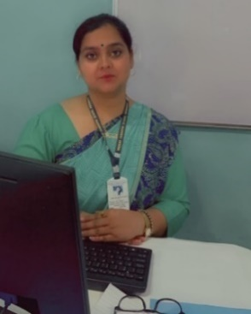
The Power of Positive Reinforcement in the Classroom
By:- Ms. Prabhjot Kaur
Introduction: The Importance of Positive Reinforcement
Positive reinforcement is one of the most effective strategies for promoting good behavior and academic success in the classroom. As educators, we are constantly looking for ways to motivate and encourage students to perform at their best. Positive reinforcement not only enhances students' learning experiences but also helps to build their self-esteem and confidence.
1. What is Positive Reinforcement?
Definition: Positive reinforcement involves rewarding or acknowledging students when they display desirable behaviors, such as completing assignments, participating in class, or demonstrating kindness.
Objective: The goal is to strengthen these behaviors by providing positive feedback, encouraging students to continue engaging in actions that lead to success.
2. Benefits of Positive Reinforcement
Motivation: When students receive praise for their efforts, they feel motivated to continue working hard. This sense of accomplishment can drive them to set higher goals and stay focused.
Building Confidence: Regular positive reinforcement helps build students’ self-esteem. As they receive recognition for their efforts, they begin to believe in their abilities.
Positive Classroom Environment: Reinforcing positive behaviors creates a supportive and encouraging atmosphere where students feel valued and respected. This leads to better cooperation and collaboration in the classroom.
Reduction of Negative Behavior: Positive reinforcement often results in a decrease in disruptive behavior. When students are rewarded for positive actions, they are less likely to engage in negative behaviors seeking attention.
3. Methods of Positive Reinforcement
Verbal Praise: Acknowledging students with simple statements like "Well done!" or "Great effort!" can go a long way in reinforcing positive behavior.
Written Feedback: Writing encouraging notes on assignments or tests shows students that their hard work is being recognized.
Reward Systems: Implementing reward systems, such as a points-based system, stickers, or certificates, can motivate students to strive for excellence.
4. Practical Examples in the Classroom
Improving Participation: A teacher may give verbal praise every time a student contributes to class discussions, encouraging them to participate more.
Consistent Effort: Rewarding consistent homework submission with a "homework hero" certificate can encourage students to complete their assignments regularly.
5. Conclusion: The Long-Term Impact
Positive reinforcement is not just about rewarding good behavior; it's about creating an environment where students feel supported and appreciated. By using this strategy consistently, teachers can cultivate motivated, confident, and successful students who are eager to engage and excel in the classroom. The lasting impact of positive reinforcement goes beyond academics, fostering personal growth and helping students become lifelong learners.
The Sandeepni Chronicle

Slide 5
The Role of Exams in Education
By:- Mr. Vikram
Exams are an integral part of the educational system. As a teacher, I have witnessed firsthand how exams shape students' learning and development. While exams are often seen as stressful, they play a crucial role in assessing a student's academic progress, understanding of the subject matter, and their ability to apply knowledge.
1. Assessing Knowledge and Understanding
Purpose of Exams: Exams serve as a tool to evaluate the depth of knowledge students have acquired. They help teachers identify whether students have grasped the concepts taught during the course.
Comprehensive Evaluation: Through various types of questions (multiple-choice, essays, or problem-solving), exams test students' understanding of the subject as a whole, ensuring they can connect theory to practice.
Feedback for Improvement: Exams also provide feedback to students and teachers about areas of strength and weaknesses, enabling targeted improvements.
2. Fostering Discipline and Time Management
Preparation for Exams: The process of preparing for exams encourages students to develop discipline and effective study habits. They learn how to organize their time, prioritize tasks, and stay focused.
Building Time Management Skills: During exams, students are required to manage their time efficiently to complete tasks within a set period. This skill is essential not only for academic success but also in life beyond school.'
3. Promoting Critical Thinking and Problem-Solving
Application of Knowledge: Exams challenge students to go beyond rote memorization and apply what they have learned in new situations. This process fosters critical thinking and problem-solving abilities.
Encouraging Analytical Thinking: Essay-style questions or case studies encourage students to think analytically and present well-structured arguments, improving their ability to reason and evaluate information logically.
4. Preparing for Future Challenges
Simulating Real-World Scenarios: Exams simulate real-world challenges where individuals need to perform under pressure. The experience gained through exams prepares students for future endeavors in college, career, and other life challenges.
Building Resilience: The stress and pressure associated with exams help students develop resilience. Learning how to handle pressure and perform despite challenges is an invaluable skill.
5. Conclusion: A Balanced Perspective on Exams :- Exams are not just a way of assessing student performance; they also contribute to overall personal and academic growth. While they can be stressful, they offer valuable opportunities for learning, discipline, and personal development. As educators, it is essential to create a balanced approach to exams, ensuring they are fair, comprehensive, and supportive of students' growth. By doing so, we can help students navigate exams with confidence and use them as stepping stones toward success.
The Sandeepni Chronicle

Slide 6
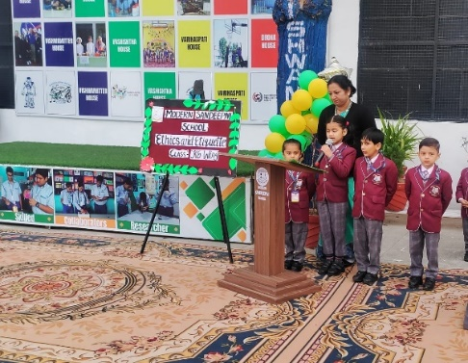
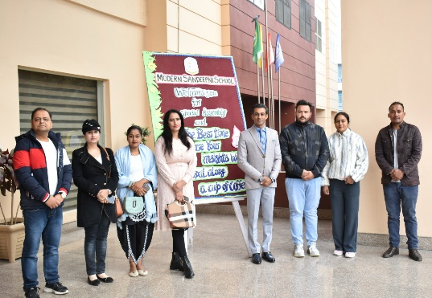
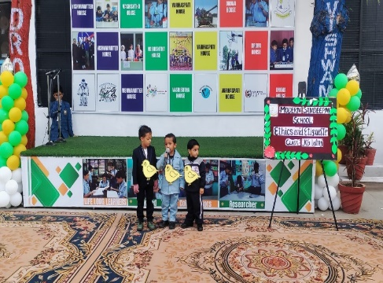
Percolating Ideas: Coffee with the Principal
Report By:- Ms. Mainsha Verma
On December 3rd, 2024, the Kindergarten Wing of the school hosted a special assembly focused on the theme “Ethics and Etiquette,” with an interactive session for parents titled “Coffee with the Principal.” The assembl led by UKG Students, emphasized the importance of instilling ethical values and good manners in young children.
The session began with Vice Principal Ms. Deeksha Bhardwaj addressing the students, highlighting the significance of ethics—distinguishing right from wrong—and etiquette—how to treat others with kindness and respect. She shared practical examples of how children can incorporate these values into their daily lives, such as saying “please” and “thank you,” being respectful to teachers and peers, and learning the value of honesty and empathy.
Following the assembly, the principal invited parents for a “Coffee with the Principal” session, encouraging open dialogue about the role of both the school and families in nurturing ethical behavior and social skills. Dr. Puri emphasized that teaching ethics and etiquette starts at home, with parents being key role models. He encouraged parents to demonstrate these values in everyday interactions, as children are more likely to emulate the behaviors they observe.
The conversation also touched upon the school’s efforts to support social-emotional development through curriculum activities and role-playing exercises that teach empathy, conflict resolution, and responsibility. Dr. Puri spoke about the importance of creating a collaborative environment between parents and the school, where both parties work together to foster respect, kindness, and inclusivity in children.
The session concluded with a productive conversation, where parents shared their experiences and sought advice. Dr. Puri expressed his appreciation for the parents’ ongoing support and commitment to creating a positive, ethical environment for the students.
The Sandeepni Chronicle

Slide 7
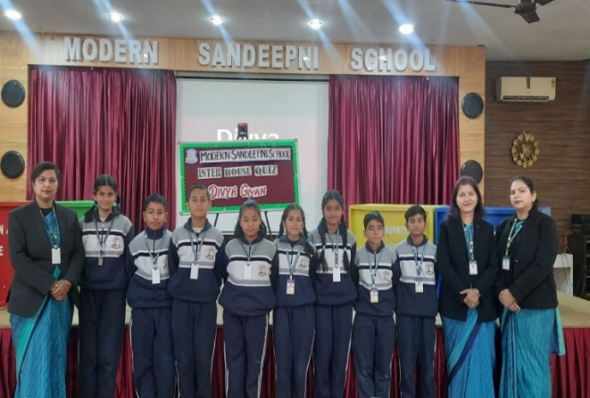
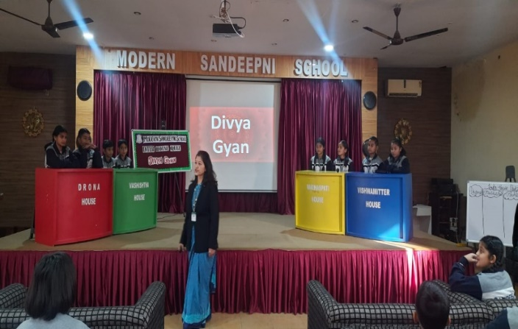
Inter House Quiz – Divya Gyan
Report By:- Mrs.Mohnia Pathania
"दिव्यं ज्ञानं परमं शक्तिः, तमेव मोक्षस्य कारणम्। ज्ञानदीपेन भास्वता, तमसो नाशकं भवेत्।।"
"Divine knowledge is the supreme power and the cause of liberation. With the radiant lamp of knowledge, it dispels the darkness of ignorance.“
Description of the Event:
A quiz competition on the topic "Divya Gyan" was conducted to enhance students’ knowledge, encourage critical thinking, and foster a spirit of healthy competition. The event witnessed enthusiastic participation and showcased the students’ curiosity and understanding of divine knowledge and related concepts. The quiz was divided into five engaging rounds, each designed to test different aspects of the participants' knowledge and skills:
Round 1: Choose the Right Option- High accuracy in responses showed strong foundational knowledge.
Round 2: Guess from the Clue - This round brought out the creative thinking abilities of the participants.
Round 3: Picture Recognition- The visual nature of the round captured the attention and imagination of the participants.
Round 4: Out of the Box - Encouraged participants to approach problems with creativity and logic.
Round 5: Rapid Fire Round - The speed and accuracy of responses made this round highly competitive and exciting.
After a closely contested competition, the winning team was Vishwamittra. It was an enriching experience for all and highlighted the importance of learning in a fun and interactive way.
The Sandeepni Chronicle

Slide 8
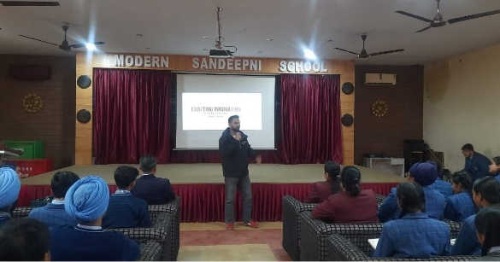
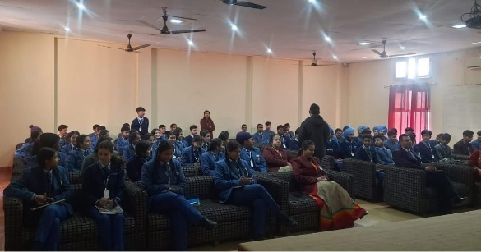
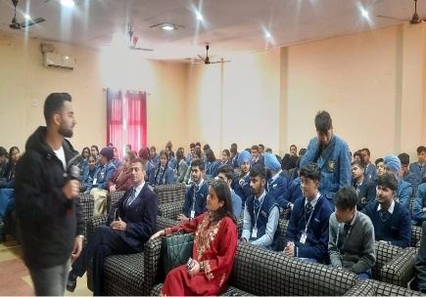
Unlocking Innovation: A Seminar on Patent Awareness for Future Creators
Report By:- Ms. Aradhna
A stimulating and informative seminar on "PATENT Awareness" was conducted for the students of Class XI and XII at our school. The session aimed at enlightening students on the importance of patents, innovation, and intellectual property, providing them with valuable knowledge about the world of patents and how they influence creativity and technological advancement.
Keynote Speaker: Mr. Aakash - Patent Expert
The seminar was hosted by Mr. Aakash, a proud alumnus of Shoolini University and a leading expert in patents, often referred to as the "Patent Man". Mr. Aakash’s deep understanding of the patent landscape, along with his passion for innovation, made the session both engaging and informative. With years of experience in the field, he brought a wealth of knowledge to the students, offering them a glimpse into the world of intellectual property and its significance in today’s fast-paced, innovation-driven world
Seminar Highlights
Introduction to Patents: Mr. Aakash began the session by explaining the fundamental concept of patents and how they serve as legal protections for inventions, ideas, and innovations. He emphasized how patents encourage creativity and allow inventors to safeguard their ideas.
Understanding Intellectual Property: The seminar also delved into the broader field of intellectual property (IP), exploring various types, including copyrights, trademarks, and trade secrets, and how they protect original works and innovations.
Importance of Patents in Innovation: Mr. Aakash shared real-world examples of how patents have played a pivotal role in advancing technology and shaping industries. He highlighted how patents help innovators profit from their creations and contribute to global progress by encouraging further research and development.
Patent Filing Process: Students were also introduced to the patent filing process and the steps involved in obtaining a patent, from idea conceptualization to submitting a formal application with the relevant authorities.
Interactive Q&A Session: The seminar included an interactive Q&A session where students actively engaged with Mr. Aakash, asking insightful questions about patenting, innovation, and intellectual property laws. This allowed students to deepen their understanding and seek clarifications on various aspects.
Conclusion: A Session to Inspire Future Innovators
The seminar was a highly enriching experience for all attendees, providing them with a solid understanding of the patenting world and its relevance to the modern age of technology and invention. Mr. Aakash’s insights inspired many students to think creatively and consider the value of protecting their own innovative ideas. This session served as a stepping stone for future innovators, helping them appreciate the significance of intellectual property in today’s competitive world.
The school extends its heartfelt thanks to Mr. Aakash for his valuable contribution and looks forward to more such enlightening sessions in the future.
The Sandeepni Chronicle

Slide 9
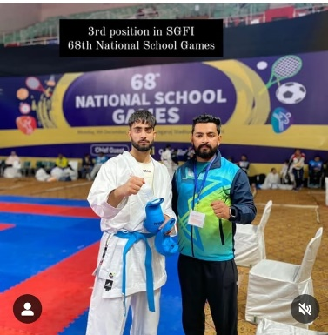
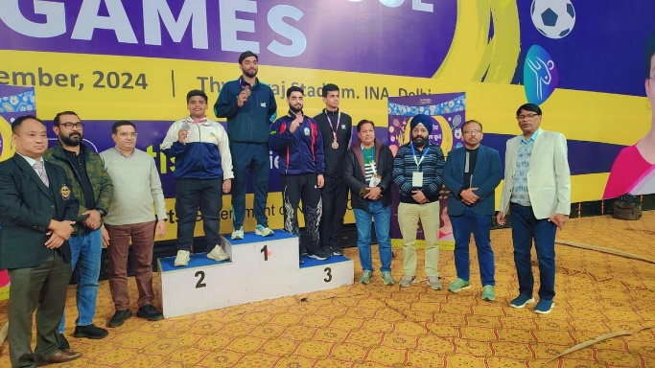
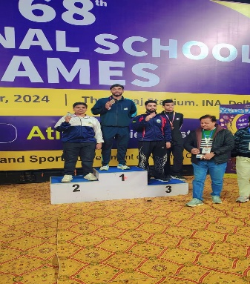
Karate Champion: Mir Sarwar’s Inspiring Journey to National Glory
Report By:- Mr. Sushil Thakur
We are thrilled to announce the remarkable achievement of Mr. Mir Sarwar Kaisar, a talented student from Srinagar, who secured the 3rd position in the Nation U-17 Karate competition at the 68th National School Games, organized by the School Games Federation of India in New Delhi. This outstanding achievement highlights not only his dedication and hard work but also the spirit of excellence fostered at Modern Sandeepni School.
Mir’s Inspiring Journey in Karate
Passion for Karate: Mir Sarwar Kaisar shared his inspiring journey in a special video, where he discussed how his passion for karate began at a young age. He spoke about the discipline, focus, and dedication required to succeed in the sport, emphasizing how his love for karate has shaped his personal growth and determination.
Challenges and Triumphs: Throughout the video, Mir described the various challenges he faced on his path to success. Despite the hardships, his perseverance and commitment to training helped him overcome obstacles and achieve his goals. His journey serves as a testament to the importance of hard work and never giving up.
The Role of School
Supportive Environment: Mir credited Modern Sandeepni School for being a strong pillar of support in his athletic journey. He expressed gratitude to the school for providing him with the necessary resources, guidance, and encouragement to pursue his passion for sports alongside academics.
Encouraging Excellence in Sports: The school’s focus on promoting sports and extracurricular activities has been instrumental in shaping students like Mir. With the support of his coaches and teachers, Mir has been able to excel both academically and athletically.
Conclusion: A Star in the Making
Mir Sarwar Kaisar’s achievement is a proud moment for our school, and his journey inspires all of us to chase our dreams with dedication and perseverance. We are incredibly proud of his success at the national level and look forward to seeing him continue to achieve greatness in the world of karate. His dedication to excellence is a true reflection of the values instilled at Modern Sandeepni School.
The Sandeepni Chronicle

Slide 10
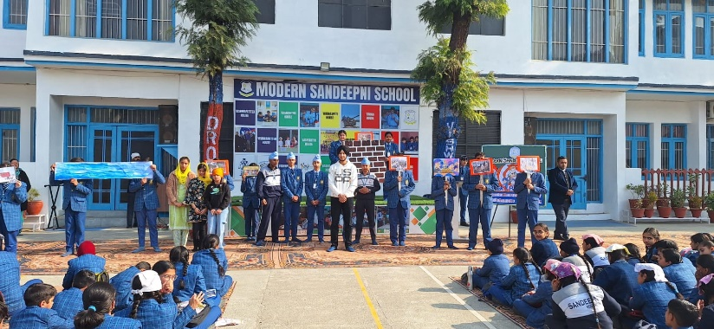
Honoring Sacrifice and Courage: Veer Baal Diwas Celebration
Report By:- Ms.Navneet Kaur
On 24th December, the celebration of Veer Baal Diwas was held to honour the martyrdom of the younger sons of Guru Gobind Singh Ji who sacrificed their lives for the sake of the nation. The event was organized with great enthusiasm and respect for the sacrifices made by the revered Sikh Gurus.
Event Overview
The event commenced with a special prayer and Shabad to invoke blessings for the nation. The principal of the school, Mr. Neeraj Mohan Puri, addressed the students, emphasizing the importance of learning about the sacrifices of Guru Gobind Singh Ji and his sons.
Key Highlights of the Celebration
Lecture by Director Er. Pawan Mahajan Er. Pawan Mahajan, a distinguished speaker, provided an enlightening lecture on the sacrifices made by Guru Gobind Singh Ji. He discussed how Guru Ji and his family dedicated themselves for the safety and welfare of the nation. Er. Mahajan detailed the story of the two young sons, Baba Zorawar Singh and Baba Fateh Singh, who were martyred at a tender age of just 9 and 7, respectively. Their martyrdom was a testament to their devotion to truth and justice, symbolizing the immense courage and resolve to uphold Sikh values.
Principal's Address Mr. Neeraj Mohan Puri addressed the gathering and urged the students to understand the significance of this day. He spoke about the sacrifices made by Guru Gobind Singh Ji and the strength of character that his sons exhibited. Principal Puri emphasized that such heroic acts should be celebrated, and the younger generation should take inspiration from them to serve the nation selflessly.
Shabad and Religious Prayers The students and staff joined in singing Shabad in reverence to the Sikh martyrs. The spiritual atmosphere during the prayers helped instill a sense of respect and admiration for the Guru’s sacrifices.
Message and Impact
The event underscored the importance of remembering the contributions and sacrifices of our national heroes. Through the informative speeches and prayers, the students were reminded of the core Sikh values of bravery, sacrifice, and selflessness. The celebration of Veer Baal Diwas aimed to strengthen their moral compass and instill in them a sense of patriotism.
The observance of Veer Baal Diwas was a meaningful reminder for everyone present of the sacrifices made for the greater good, and the importance of upholding the values of truth, courage, and commitment to the nation.
The Sandeepni Chronicle

Slide 11
Student Leadership: The Importance of Being a Responsible Role Model
By:- Yuvraj Thakur ( XII Commerce)
Examinations are a fundamental part of a student’s academic life. They are designed to evaluate the knowledge, understanding, and skills that a student acquires over time. While exams can be stressful, they play an essential role in shaping a student’s discipline, focus, and sense of responsibility.
Purpose of Examinations:- Examinations serve multiple purposes. They provide a way to assess a student’s grasp of various subjects and highlight their strengths and areas for improvement. Exams also encourage students to study consistently, helping them develop better time management and organizational skills.
Benefits of Examinations
Self-Assessment: Exams help students gauge their progress and understand their level of preparation.
Motivation to Learn: Knowing that they will be tested motivates students to study regularly and stay focused.
Building Confidence: Successfully completing exams fosters a sense of accomplishment and boosts self-esteem.
Skill Development: Exams teach time management, problem-solving, and critical thinking.
Challenges Faced by Students:- Despite their benefits, examinations can be stressful for many students. The pressure to perform well can lead to anxiety, sleeplessness, and a lack of concentration. In some cases, students may resort to rote learning instead of understanding concepts, which defeats the purpose of education.
Additionally, exams are not always the best way to measure a student’s capabilities, as some students excel in practical skills or creative thinking that cannot always be assessed through traditional tests.
How to Approach Examinations:- To reduce stress and perform well, students should approach exams with a positive mindset. A structured study plan, regular revision, and consistent practice can go a long way in building confidence. Students should also focus on their health by eating nutritious food, getting enough sleep, and taking short breaks during study sessions.
Conclusion:- Examinations, though challenging, are an integral part of education. They test not only a student’s knowledge but also their ability to manage pressure and stay disciplined. By viewing exams as opportunities for growth rather than obstacles, students can overcome their fears and achieve their goals. With the right preparation and mindset, examinations can become stepping stones to success.
The Sandeepni Chronicle

Slide 12
समाज में नैतिकता और शिष्टाचार का महत्व
By:-Kunwar Shauryaveer ( VIII Peace)
समाज में नैतिकता और शिष्टाचार का अत्यधिक महत्व है क्योंकि ये दोनों तत्व समाज के स्वस्थ और समृद्धि की दिशा में योगदान करते हैं। ये हमारे व्यक्तित्व और समाज में दूसरों के साथ हमारे संबंधों को बेहतर बनाते हैं।
1. नैतिकता का महत्व
नैतिकता का अर्थ है सही और गलत के बीच अंतर समझना और उसे जीवन में अपनाना। यह हमारे निर्णयों, कार्यों और विचारों को सही दिशा में मार्गदर्शन करता है। समाज में नैतिकता के निम्नलिखित लाभ हैं:
सामाजिक विश्वास: जब लोग नैतिकता का पालन करते हैं, तो समाज में विश्वास और ईमानदारी का माहौल बनता है। यह समाज को मजबूत बनाता है और लोगों के बीच सहयोग की भावना उत्पन्न करता है।
न्याय और समानता: नैतिकता समाज में न्याय और समानता की भावना पैदा करती है। यह सुनिश्चित करती है कि सभी को समान अधिकार मिले और कोई भी किसी अन्याय का शिकार न हो।
2. शिष्टाचार का महत्व
शिष्टाचार का तात्पर्य दूसरों के प्रति आदर्श आचरण और सही व्यवहार से है। यह समाज में अनुशासन और सद्भाव बनाए रखने में सहायक होता है। शिष्टाचार के निम्नलिखित लाभ हैं:
आपसी सम्मान: शिष्टाचार हमें दूसरों का सम्मान करना सिखाता है। यह समाज में सौहार्दपूर्ण संबंधों का निर्माण करता है और हर किसी को अपनी प्रतिष्ठा बनाए रखने का अवसर प्रदान करता है।
विनम्रता का महत्व: शिष्टाचार हमें विनम्रता सिखाता है, जिससे हम दूसरों के साथ बेहतर संवाद कर सकते हैं और अपने कार्यों से उन्हें प्रभावित कर सकते हैं।
3. नैतिकता और शिष्टाचार के सामूहिक लाभ
समाज में शांति: नैतिकता और शिष्टाचार समाज में शांति बनाए रखने में मदद करते हैं। ये दोनों गुण एक सकारात्मक और सहायक वातावरण का निर्माण करते हैं।
व्यक्तिगत विकास: जब हम नैतिकता और शिष्टाचार का पालन करते हैं, तो हम व्यक्तिगत रूप से भी बेहतर इंसान बनते हैं। यह हमारे व्यक्तित्व को निखारता है और दूसरों के प्रति हमारी सोच और कार्यशैली को सुधारता है।
निष्कर्ष
समाज में नैतिकता और शिष्टाचार का पालन करना अत्यंत आवश्यक है। यह समाज को एकजुट और मजबूत बनाता है, जिससे हम एक स्वस्थ और शांतिपूर्ण जीवन जी सकते हैं। यदि हम सभी इन दोनों का अनुसरण करें, तो न केवल हम अच्छे इंसान बनेंगे, बल्कि समाज में सकारात्मक परिवर्तन भी ला सकेंगे।
The Sandeepni Chronicle

Slide 13
ਸਹਿਯੋਗ ਅਤੇ ਟੀਮਵਰਕ ਦਾ ਮਹੱਤਵ
By:- Arnav Gupta ( IX Loyal)
ਸਹਿਯੋਗ ਅਤੇ ਟੀਮਵਰਕ ਕਿਸੇ ਵੀ ਸਮੂਹਿਕ ਕੰਮ ਜਾਂ ਪ੍ਰੋਜੈਕਟ ਵਿੱਚ ਸਫਲਤਾ ਦੀ ਕੁੰਜੀ ਹੁੰਦੇ ਹਨ। ਜਦੋਂ ਲੋਕ ਇਕੱਠੇ ਮਿਲ ਕੇ ਕੰਮ ਕਰਦੇ ਹਨ, ਤਾਂ ਉਹ ਇੱਕ-ਦੂਜੇ ਦੀ ਮਦਦ ਨਾਲ ਵੱਡੇ ਲਕੜੇ ਹਾਸਲ ਕਰ ਸਕਦੇ ਹਨ। ਸਹਿਯੋਗ ਅਤੇ ਟੀਮਵਰਕ ਨਾਲ, ਨਾ ਸਿਰਫ ਕੰਮ ਦਾ ਮੁਕਾਬਲਾ ਆਸਾਨ ਹੁੰਦਾ ਹੈ, ਸਗੋਂ ਇਹ ਵਿਅਕਤੀਆਂ ਵਿੱਚ ਭੈਚਾਰਾ ਅਤੇ ਮਜ਼ਬੂਤ ਰਿਸ਼ਤੇ ਵੀ ਬਣਾਉਂਦਾ ਹੈ।
1. ਸਹਿਯੋਗ ਦੇ ਫਾਇਦੇ
ਉੱਚੀ ਪ੍ਰਦਰਸ਼ਨ ਦੀ ਯੋਗਤਾ: ਜਦੋਂ ਲੋਕ ਇਕੱਠੇ ਕੰਮ ਕਰਦੇ ਹਨ, ਤਾਂ ਹਰ ਇੱਕ ਦੀ ਤਾਕਤ ਅਤੇ ਕਾਬਲੀਅਤ ਦਾ ਇਸਤੇਮਾਲ ਕੀਤਾ ਜਾ ਸਕਦਾ ਹੈ। ਇਸ ਨਾਲ ਟੀਮ ਦਾ ਸਮੂਹਿਕ ਪ੍ਰਦਰਸ਼ਨ ਸੁਧਰਦਾ ਹੈ।
ਬਹੁ-ਪੱਖੀ ਸੋਚ: ਸਹਿਯੋਗ ਨਾਲ, ਵੱਖ-ਵੱਖ ਲੋਕ ਆਪਣੇ ਖਿਆਲ ਅਤੇ ਵਿਚਾਰ ਸਾਂਝੇ ਕਰਦੇ ਹਨ। ਇਸ ਨਾਲ ਸਮੱਸਿਆਵਾਂ ਦਾ ਹੱਲ ਲੱਭਣ ਵਿੱਚ ਮਦਦ ਮਿਲਦੀ ਹੈ, ਕਿਉਂਕਿ ਹਰ ਇੱਕ ਦਾ ਨਜ਼ਰੀਆ ਅਲੱਗ ਹੁੰਦਾ ਹੈ।
ਬਾਹਰੀ ਮਦਦ ਅਤੇ ਸਹਾਇਤਾ: ਜਦੋਂ ਕੋਈ ਵਿਅਕਤੀ ਕਿਸੇ ਸਮੱਸਿਆ ਵਿੱਚ ਫਸਦਾ ਹੈ, ਤਾਂ ਟੀਮ ਦੇ ਮੈਂਬਰਾਂ ਤੋਂ ਮਿਲਦੀ ਮਦਦ ਉਸਨੂੰ ਸਹਾਰਾ ਦਿੰਦੀ ਹੈ ਅਤੇ ਸਮੱਸਿਆ ਹੱਲ ਹੋ ਜਾਂਦੀ ਹੈ।
2. ਟੀਮਵਰਕ ਦੇ ਫਾਇਦੇ
ਬਿਹਤਰ ਸੰਚਾਰ: ਟੀਮਵਰਕ ਨਾਲ ਲੋਕ ਇੱਕ ਦੂਜੇ ਨਾਲ ਖੁਲ ਕੇ ਗੱਲ ਕਰਦੇ ਹਨ। ਇਸ ਨਾਲ ਵਧੀਆ ਸੰਚਾਰ ਹੁੰਦਾ ਹੈ, ਜੋ ਕੰਮ ਕਰਨ ਦੀ ਸਮਰਥਾ ਨੂੰ ਵਧਾਉਂਦਾ ਹੈ।
ਮੋਟੀਵੇਸ਼ਨ ਅਤੇ ਪ੍ਰੇਰਣਾ: ਟੀਮ ਵਿੱਚ ਰਹਿਣ ਨਾਲ ਵਿਅਕਤੀ ਨੂੰ ਹੌਸਲਾ ਮਿਲਦਾ ਹੈ। ਇਕ ਦੂਜੇ ਦੀ ਸਹਾਇਤਾ ਨਾਲ ਟੀਮ ਦੇ ਮੈਂਬਰਾਂ ਨੂੰ ਕੰਮ ਕਰਨ ਲਈ ਪ੍ਰੇਰਣਾ ਮਿਲਦੀ ਹੈ ਅਤੇ ਉਹ ਇੱਕ ਦੂਜੇ ਨੂੰ ਮਜ਼ਬੂਤ ਬਣਾਉਂਦੇ ਹਨ।
ਸਮੱਸਿਆ ਹੱਲ ਕਰਨ ਵਿੱਚ ਤੇਜ਼ੀ: ਟੀਮਵਰਕ ਦੇ ਨਾਲ, ਜੋ ਵੀ ਸਮੱਸਿਆ ਆਉਂਦੀ ਹੈ, ਉਸਦਾ ਹੱਲ ਜਲਦੀ ਲੱਭਿਆ ਜਾ ਸਕਦਾ ਹੈ। ਕਿਉਂਕਿ ਹਰ ਇੱਕ ਵਿਅਕਤੀ ਦੀ ਆਪਣੇ ਖੇਤਰ ਵਿੱਚ ਮਾਹਿਰਤਾ ਹੁੰਦੀ ਹੈ, ਇਸ ਨਾਲ ਕੰਮ ਕਮ ਸਮੇਂ ਵਿੱਚ ਪੂਰਾ ਹੋ ਜਾਂਦਾ ਹੈ।
3. ਸਹਿਯੋਗ ਅਤੇ ਟੀਮਵਰਕ ਦਾ ਸਕੂਲ ਜ਼ਿੰਦਗੀ 'ਚ ਅਹਿਮੀਅਤ
ਪੜਾਈ ਵਿੱਚ ਸਹਿਯੋਗ: ਸਕੂਲ ਵਿੱਚ ਸਹਿਯੋਗ ਅਤੇ ਟੀਮਵਰਕ ਵਿਦਿਆਰਥੀਆਂ ਨੂੰ ਸਮੂਹਿਕ ਪ੍ਰੋਜੈਕਟ ਅਤੇ ਪ੍ਰਜ਼ੈਂਟੇਸ਼ਨ ਵਿੱਚ ਸਹਾਰਾ ਦਿੰਦੇ ਹਨ। ਇਹ ਉਨ੍ਹਾਂ ਨੂੰ ਸਮੱਸਿਆਵਾਂ ਦਾ ਹੱਲ ਢੂੰਢਣ ਅਤੇ ਨਵੇਂ ਵਿਚਾਰ ਲਿਆਉਣ ਵਿੱਚ ਮਦਦ ਕਰਦਾ ਹੈ।
ਖੇਡਾਂ ਵਿੱਚ ਟੀਮਵਰਕ: ਸਕੂਲ ਖੇਡਾਂ ਵਿੱਚ ਟੀਮਵਰਕ ਦਾ ਖਾਸਾ ਮਹੱਤਵ ਹੈ। ਜੇਕਰ ਹਰ ਇੱਕ ਖਿਡਾਰੀ ਆਪਣੀ ਟੀਮ ਲਈ ਖੇਡਦਾ ਹੈ, ਤਾਂ ਟੀਮ ਸਾਡਾ ਸਹਿਯੋਗ ਨਾਲ ਜਿੱਤ ਸਕਦੀ ਹੈ। ਇਸ ਨਾਲ ਵਿਦਿਆਰਥੀਆਂ ਨੂੰ ਮਜ਼ਬੂਤ ਸੰਚਾਰ, ਸਹਿਯੋਗ ਅਤੇ ਸਹਿਮਤੀ ਸਿਖਣ ਨੂੰ ਮਿਲਦੀ ਹੈ।
ਨਿਸ਼ਕਰਸ਼ :- ਸਹਿਯੋਗ ਅਤੇ ਟੀਮਵਰਕ ਨਾ ਸਿਰਫ ਸਕੂਲ ਜ਼ਿੰਦਗੀ ਵਿੱਚ, ਸਗੋਂ ਜੀਵਨ ਦੇ ਹਰ ਖੇਤਰ ਵਿੱਚ ਜਰੂਰੀ ਹਨ। ਇਹ ਲੋਕਾਂ ਨੂੰ ਇਕੱਠੇ ਕਰਨ, ਸਮੱਸਿਆਵਾਂ ਦਾ ਹੱਲ ਲੱਭਣ ਅਤੇ ਸਥਿਰਤਾ ਅਤੇ ਸਫਲਤਾ ਨੂੰ ਪ੍ਰਾਪਤ ਕਰਨ ਦਾ ਰਸਤਾ ਦਿਖਾਉਂਦੇ ਹਨ। ਜਦੋਂ ਵਿਅਕਤੀ ਇਕ ਦੂਜੇ ਨਾਲ ਸਹਿਯੋਗ ਕਰਦੇ ਹਨ ਅਤੇ ਟੀਮਵਰਕ ਦਾ ਪਾਲਣ ਕਰਦੇ ਹਨ, ਤਾਂ ਉਹਨਾਂ ਨੂੰ ਨਵੀਆਂ ਉਚਾਈਆਂ 'ਤੇ ਪਹੁੰਚਣ ਵਿੱਚ ਮਦਦ ਮਿਲਦੀ ਹੈ।
The Sandeepni Chronicle

Slide 14
Parent’s Pen
Building Good Study Habits at Home
Creating effective study habits at home is essential for academic success. Here are some practical tips for parents to help their children develop strong study habits:
1. Establish a Consistent Study Routine
Set a regular time each day dedicated to studying.
Consistency helps children develop discipline and focus.
Ensure the study schedule accommodates after-school activities, dinner, and relaxation.
2. Create a Productive Study Environment
Set up a quiet, well-lit, and clutter-free study space.
Ensure the space is free from distractions like TV, phones, and noisy areas.
3. Break Tasks into Manageable Segments
Encourage children to break down large assignments into smaller, more achievable tasks.
This prevents overwhelm and keeps them motivated.
4. Set Realistic Goals and Priorities
Help your child set achievable daily or weekly goals.
Prioritize tasks based on deadlines and importance.
5. Limit Distractions
Ensure distractions, like mobile phones, are put away during study time.
Encourage focused study sessions to maximize efficiency.
Use tools like website blockers or apps that limit screen time during study hours.
7. Be Supportive and Available for Help
Be present to answer questions or provide guidance when needed.
Avoid doing the work for them but offer encouragement and motivation.
Show interest in their studies to build confidence and positive attitudes toward learning.
8. Review and Reflect
Encourage your child to review their notes regularly, not just before tests.
Reflection helps reinforce learning and identify areas that need more attention.
By nurturing these habits, parents can help their children develop a solid foundation for academic success that will benefit them throughout their educational journey.
Shaina Bhatia ( Mother of Avin Bhatia LKG Peace)
The Sandeepni Chronicle

Slide 15
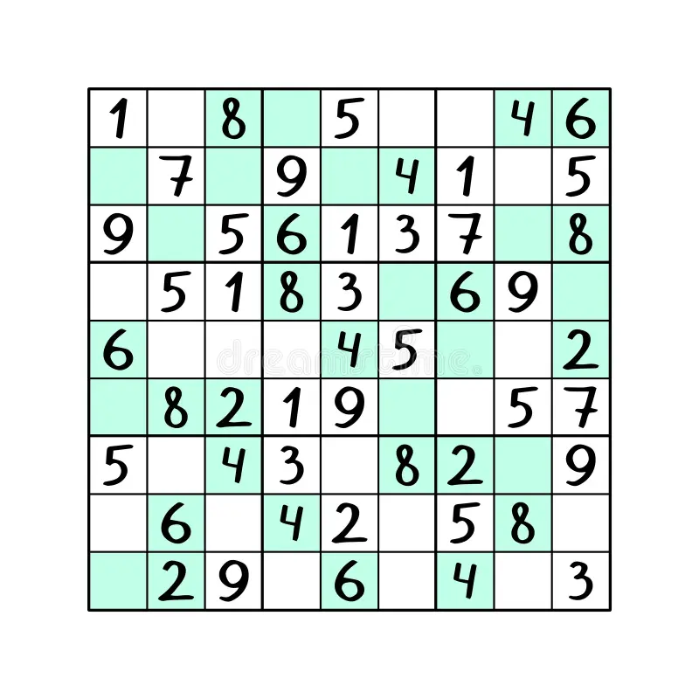
SUDOKU
By:- Deevisha ( VII Peace)
The Sandeepni Chronicle

Slide 16
Book Review
"Start with Why"by Simon Sinek
By:- Aryan Sharma ( XI Science)
Carol S. Dweck's Mindset: The New Psychology of Success is a transformative book that delves into the power of our beliefs about intelligence, ability, and potential. Dweck, a renowned psychologist, introduces the concept of two primary mindsets—fixed mindset and growth mindset—and explores how these perspectives shape our lives.
Key Ideas
Fixed Mindset: Individuals with a fixed mindset believe their abilities and intelligence are static traits. They tend to avoid challenges, fear failure, and shy away from effort, as these might expose their perceived inadequacies.
Growth Mindset: In contrast, those with a growth mindset view intelligence and abilities as qualities that can be developed through effort, learning, and perseverance. They embrace challenges, see failures as opportunities for growth, and value effort as a path to mastery.
Application Across Life:
In education, Dweck demonstrates how fostering a growth mindset can help students achieve greater academic success by embracing challenges and valuing effort over innate ability.
In business, she explains how leaders with a growth mindset build more resilient and innovative organizations.
In personal relationships, she illustrates how adopting a growth mindset can lead to healthier, more fulfilling interactions.
Strengths
Practical Examples: The book is rich with real-life examples, from classrooms to boardrooms, illustrating the transformative power of mindset shifts.
Actionable Insights: Dweck provides practical advice on how to cultivate a growth mindset, making it accessible for readers to apply in their own lives.
Universality: The concepts are relevant to people of all ages, professions, and walks of life, making it a powerful resource for personal and professional growth.
Conclusion
Mindset: The New Psychology of Success is a must-read for anyone looking to unlock their potential and embrace a life of growth and learning. Dweck’s work is both inspiring and practical, offering tools to reframe challenges and foster resilience. Whether you're a student, educator, parent, or professional, this book offers invaluable insights to help you thrive in every aspect of life.
The Sandeepni Chronicle

Slide 17
BY:- ART & CRAFT DEPARTMENT

